Slide 1

Welcome to Java 101
Learning the fundamentals of Java
With Cameron McKenzie
(We'll get started soon, around 9am CST. I believe Richmond and Chicago are in the call, so we are working on Central time)

Slide 2
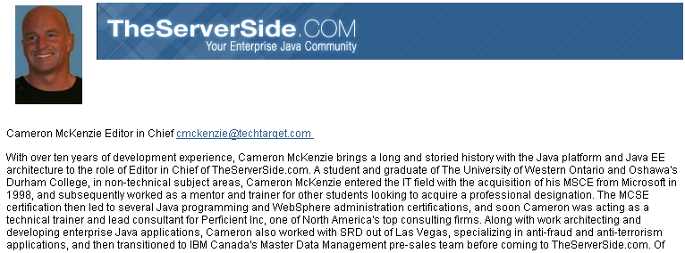




About Me…

Slide 3
Class logistics
Class hours: 9-5
Mealtime: noonish
Breaks? We'll see
  It's all about classroom management!
Audio: please mute yourself when not engaged in the group
Virtual Support Team
VirtualSupport@ProTechTraining.com
(800) 373-9188 (x299)

Slide 4
Class logistics
Class hours: 9-5
Mealtime: noonish
Breaks? We'll see
  It's all about classroom management!
Audio: please mute yourself when not engaged in the group
I will be sharing files here:\\COMPUTER150\shared_stuff
Virtual Support Team
VirtualSupport@ProTechTraining.com
(800) 373-9188 (x299)

Slide 5
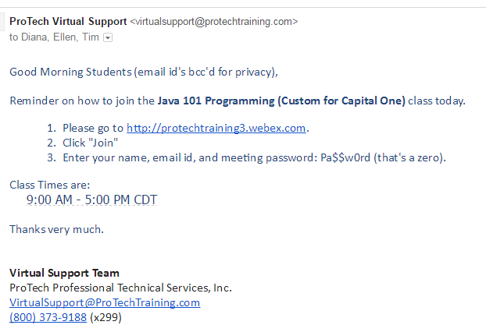
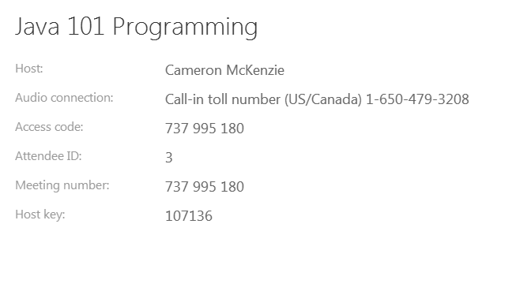
Class logistics
Class hours: 9-5
Mealtime: noonish
Breaks? We'll see
  It's all about classroom management!
Audio: please mute yourself when not engaged in the group
Virtual Support Team
VirtualSupport@ProTechTraining.com
(800) 373-9188 (x299)

Slide 6
Access the remote lab computers by going to http://labs.protechtraining.com
Name | User ID | Password
Chakrapani | 151 | Pa$$wØrd | (Capital P, Ø is a zero)
Neil | 152 | Pa$$wØrd
Rendheer | 153 | Pa$$wØrd
Anuradha | 154 | Pa$$wØrd
Denise | 155 | Pa$$wØrd
Empress | 156 | Pa$$wØrd
Tracey | 157 | Pa$$wØrd
Alex | 158 | Pa$$wØrd
Kayne | 159 | Pa$$wØrd
Irina | 160 | Pa$$wØrd
Valerie | 161 | Pa$$wØrd
Ashok | 162 | Pa$$wØrd
Emma | 163 | Pa$$wØrd
Mohammad | 164 | Pa$$wØrd
Praveen | 165 | Pa$$wØrd
Craig | 166 | Pa$$wØrd
Vaibhav | 167 | Pa$$wØrd
Abha | 168 | Pa$$wØrd
Prithvi | 169 | Pa$$wØrd
From a New Browser window, Navigate to http://labs.protechtraining.com
Click Login and you will be immediately redirected to your remote lab computer.

Slide 7
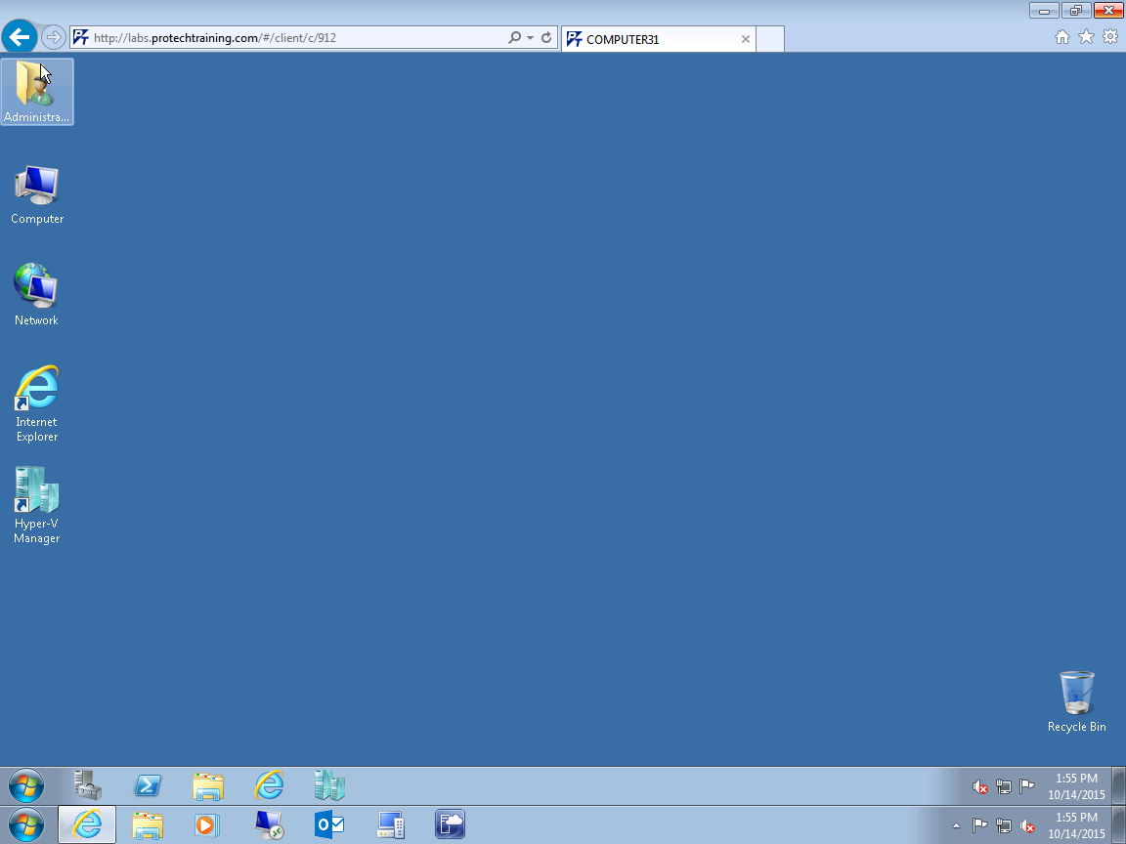

To avoid confusion with multiple task bars, it is advisable to place your browser into Full Screen mode. Steps may be different based on which browser you are using. Most browsers can be toggled in and out of
Full Screen mode by hitting the F11 key.

Slide 8
The Code Scramble
Go to the following URL:
  https://github.com/java-city/java101/wiki/01-first-scramble
It might be easier to go to the shortened URL:
  https://goo.gl/iLXmPL
The code fell on the ground, and I didn't have a chance to put it back together again. I need your help organizing the code. Put it all back together, and you should have a nice Rock-Paper-Scissors game at your disposal

Slide 9
The Code Scramble
Go to the following URL:
  https://github.com/java-city/java101/wiki/01-first-scramble
It might be easier to go to the shortened URL:
  https://goo.gl/iLXmPL
The code fell on the ground, and I didn't have a chance to put it back together again. I need your help organizing the code. Put it all back together, and you should have a nice Rock-Paper-Scissors game at your disposal

Slide 10
Lab Time!!!
It's lab time. No more lecture or pedantic meanderings from your loquacious facilitator. Your job is to do Lab 1 and Lab 2!
  Lab 1: Importing the Java2UML file is error prone. The directory you point is lab01. Then drill down through com\descriptor\javautils in the other window. (It's confusing)
  Run As – Run Configurations is a bit confusing. Run Configurations is the bottom link. A new window appears and you need to click on the Arguments tab

